Slide 1
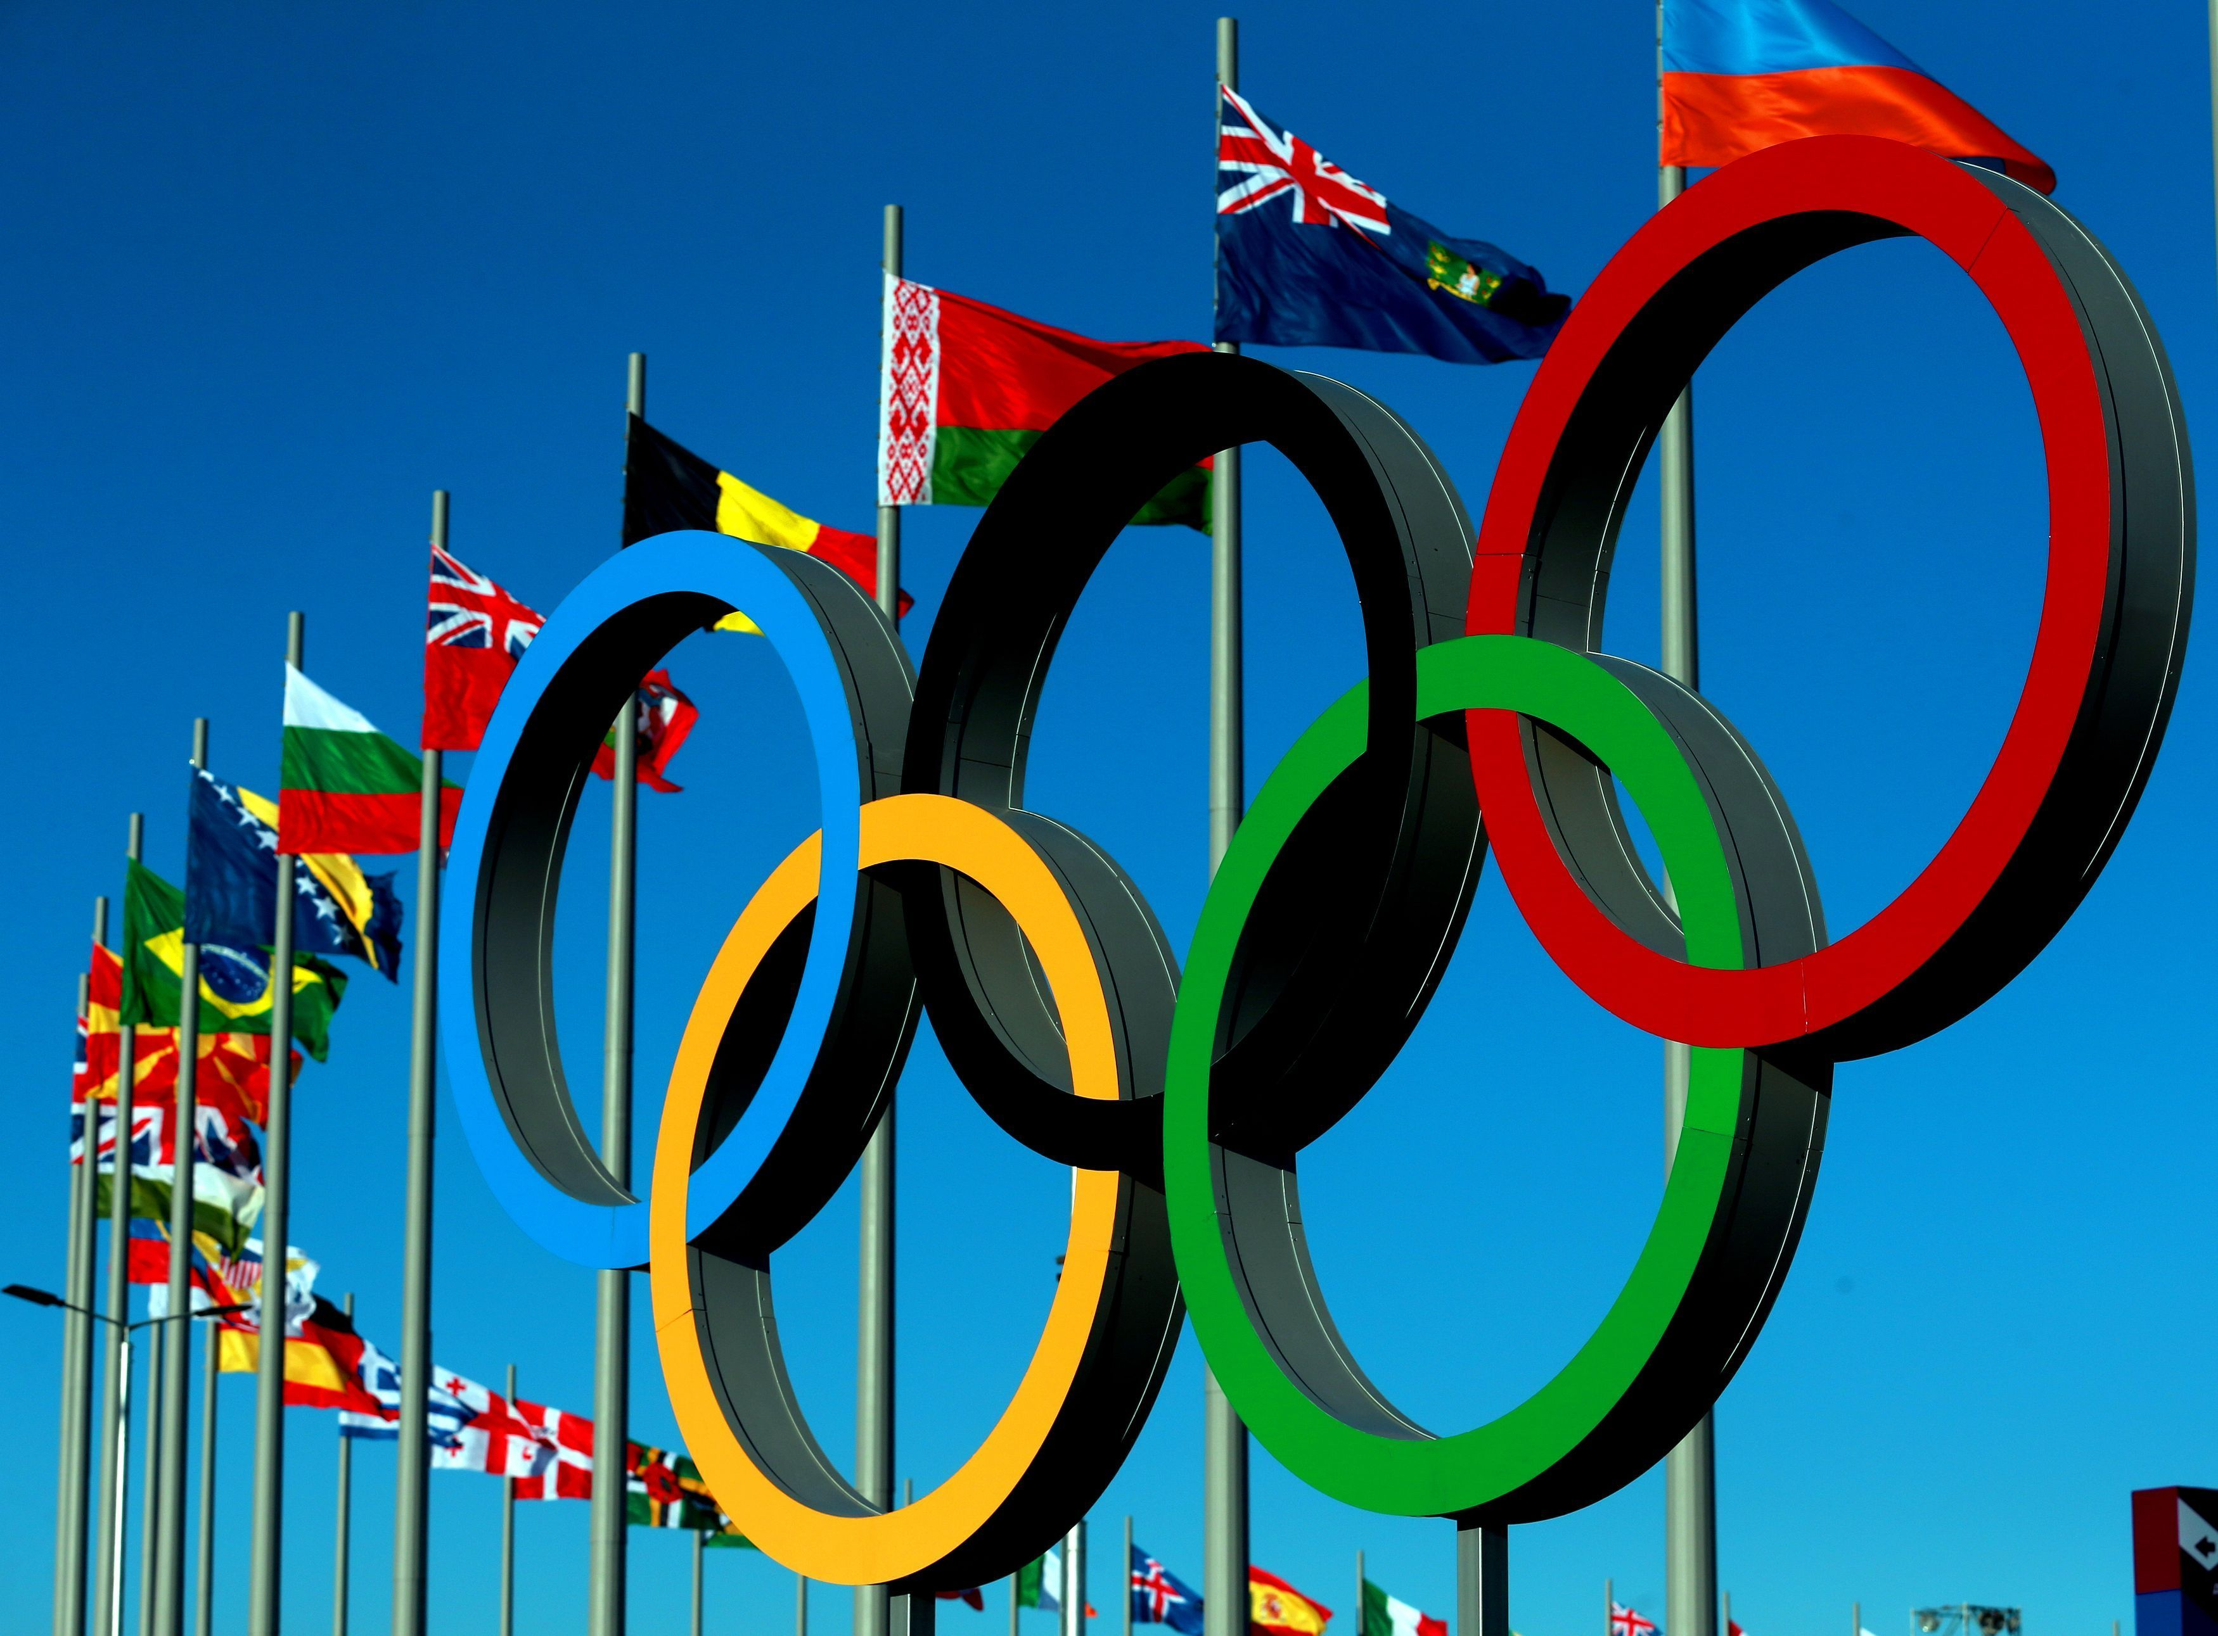
Capstone Project Olympic Sports Analysis
By- Deepak Rajbhar

Slide 2
Introduction:
The Olympic Sports Analysis project aims to analyze Olympic sports data using SQL for data manipulation, Problem Solving and Power BI for visualization. This Presentation outlines the project methodology, data analysis techniques, and dashboard design for comprehensive insight into the Olympic Games. The resulting visualization provides valuable insights for readers and stakeholders interested in the Olympic games. While not overly complex, it establishes a solid foundation for understanding historical performances across countries.

Slide 3
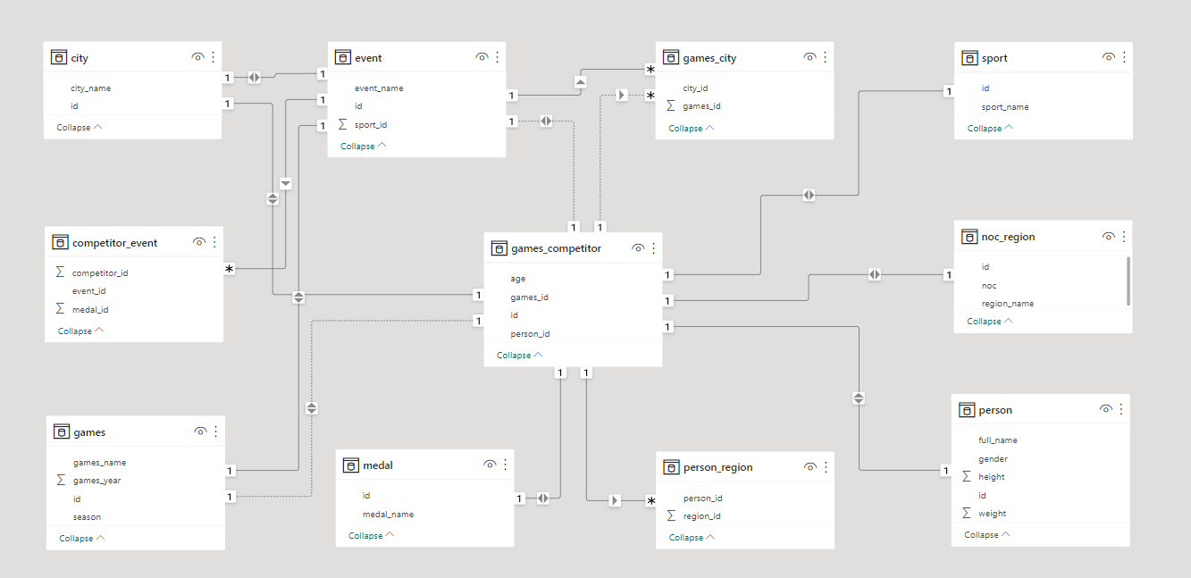
Modal View For Olympic Sports Analysis (ER Diagram):

Slide 4
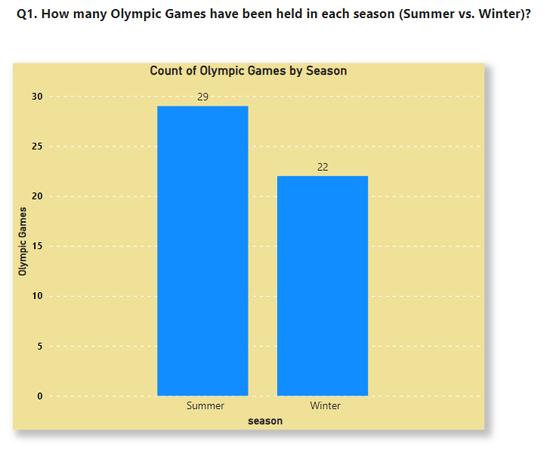
Conclusion: Analyzing the frequency of Olympic Games by season highlights the historical distribution between Summer and Winter editions. According to our Dataset Olympic games games has held more time in Summer than Winter. This examination reveals sports typically associated with warmer climates compared to the more specialized events of the Winter Games.

Slide 5
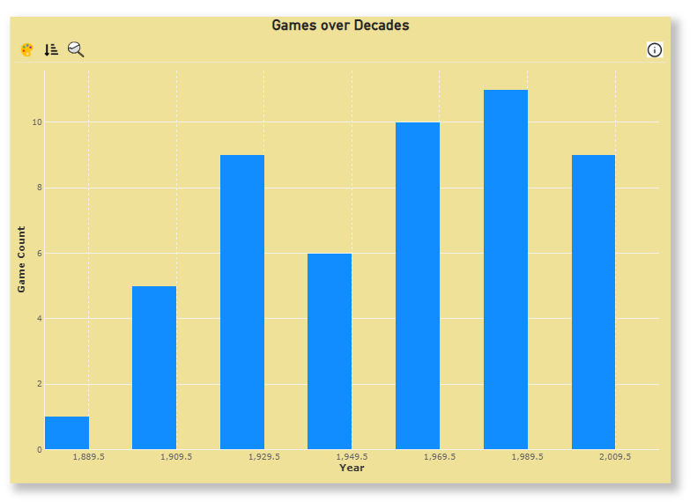
Q2. What is the distribution of games across different decades?
Conclusion: Examining the distribution of Olympic Games across decades illuminates trends in their frequency over time. With our visualization we got to know that between 1980-2000 olympic games was increased.

Slide 6
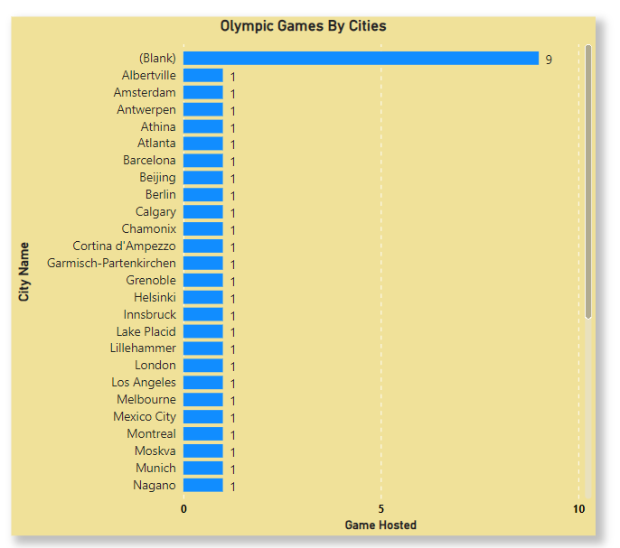
Q3. Which cities have hosted the most Olympic Games?
Conclusion: Analyzing the frequency of Olympic Games hosted by cities unveils notable hubs of sporting activity and cultural significance. According to Datasets all cities including London, Tokyo, etc have hosted single times each. These trends provides insights into the global landscape of Olympic event hosting and legacy building

Slide 7
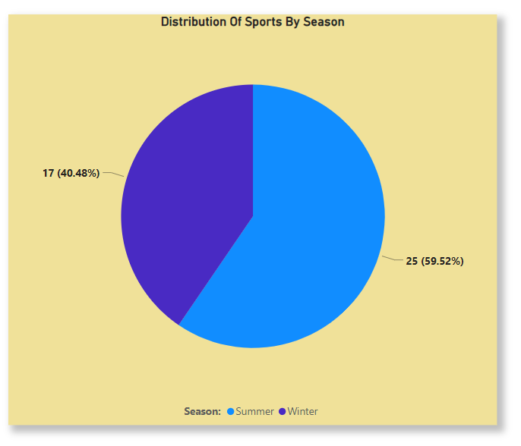
Q4 What is the distribution of sports between Summer and Winter Olympics?
Conclusion: The distribution of sports between the Summer and Winter is 60% and 40% respectively. Summer Olympics typically feature a wider variety of sports, including athletics, swimming, and gymnastics, while Winter Olympics focus on sports like skiing, skating, and ice hockey, tailored to cold weather conditions.

Slide 8
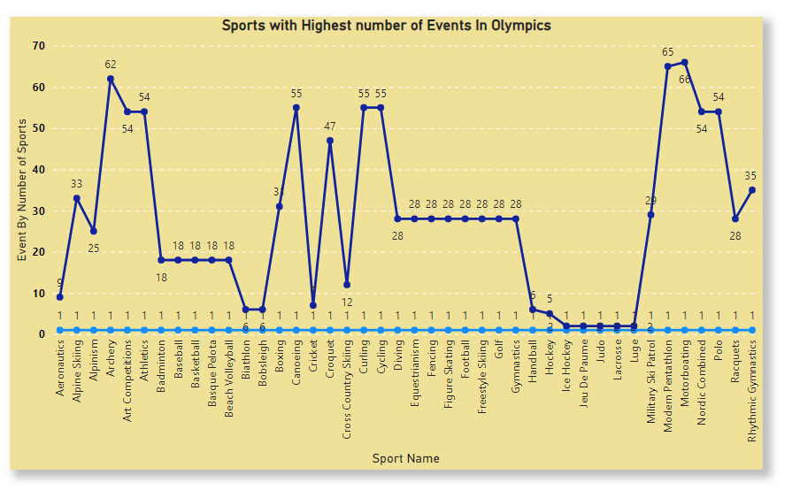
Q5 Which sports have the highest number of events in the Olympics?
Conclusion: According to dataset Sports with the highest number of events in the Olympics include Motorboating, Archery, Modern Pentathlone. These sports often offer a range of events catering to different skill sets and specialties within each sport.

Slide 9
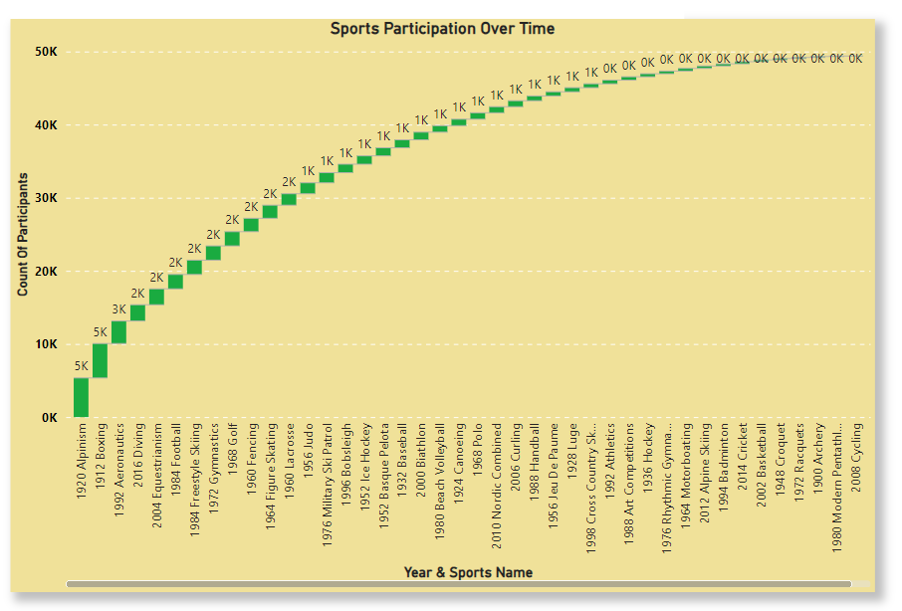
Q6. How has the participation in each sport evolved over time?
Conclusion: Analyzing the evolution of participation in each sport over time reveals dynamic trends in athletic engagement. According to Dataset in the year 1920 Alpinism, Most number of people participated. Understanding these patterns offers insights into the evolving interests and preferences of athletes.

Slide 10
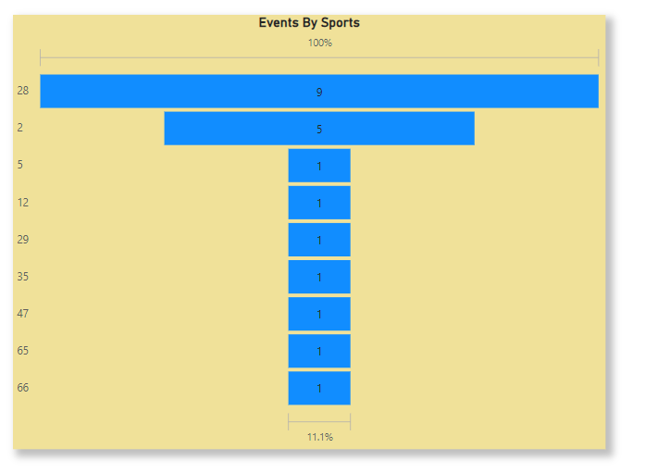
Q7. How many events are there in each sport?
Conclusion: The analysis reveals the distribution of events across various sports, providing insights into the diversity of athletic disciplines. Some sports Golf, Gymnastics, Football, etc have more number of events. It boast a multitude of events, indicating their popularity and significance within the Olympic Games, while others may have fewer events, reflecting their specialized nature or historical context.

Slide 11
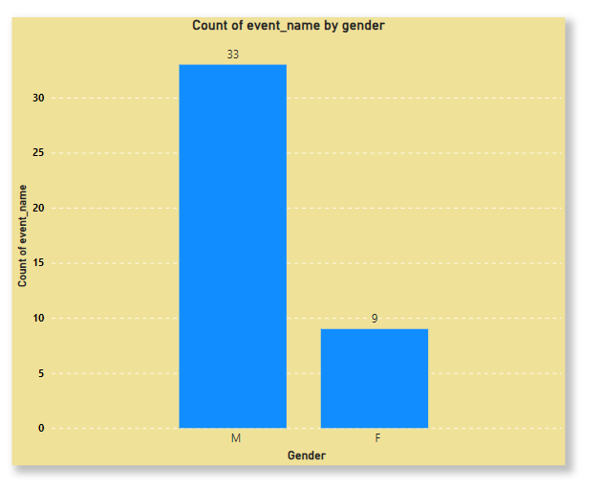
Q8. What is the distribution of events by gender (Men, Women, Mixed)?
Conclusion: The analysis unveils the gender distribution across Olympic events, showcasing the inclusivity and diversity within the Games. According to our Datasets Males Have Participated In more number Of events Than Female.

Slide 12
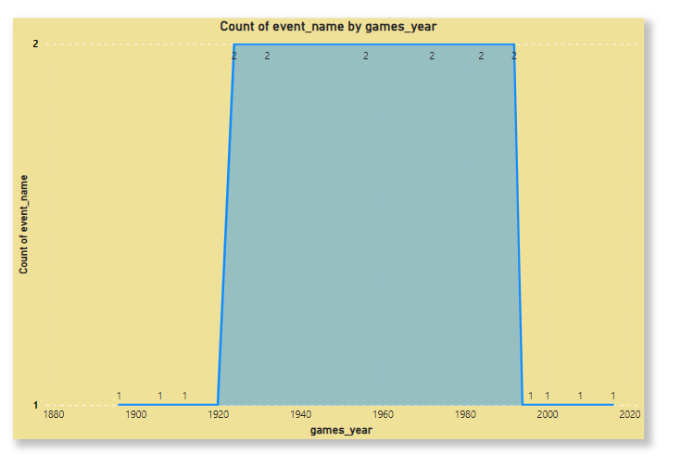
Q9. How has the number of events changed over time?
Conclusion: Analyzing the number of events over time unveils shifts in the diversity and scope of Olympic competitions. Changes may reflect the introduction of new sports, modifications to existing events, or adjustments in scheduling. Between 1920-2000 more number of Events Performed for the adaptation of the Olympic Games to contemporary trends.

Slide 13
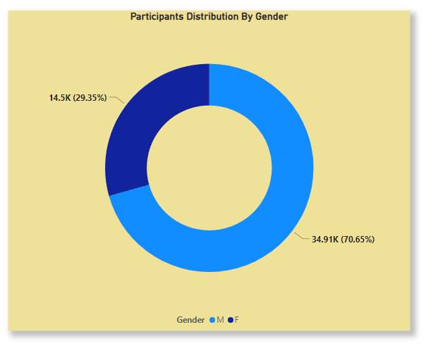
Q10. What is the distribution of participants by gender?
Conclusion: The analysis unveils the gender composition among Olympic competitors, highlighting the diversity of participation. According to given Dataset Male is Dominating Over Female as participation of male is 70% for Olympic Games.

Slide 14
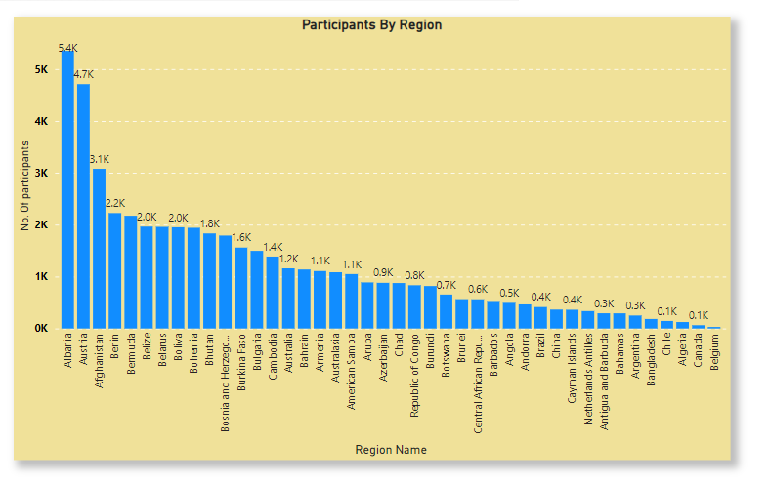
Q 11. Which countries have the highest number of participants in the Olympics?
Conclusion: According to our Dataset Countries like Albania, Austria have highest number of participants. Algeria, Canada, Belgium have least number of participants. Examining countries with the highest number of participants in the Olympics reveals global hubs of athletic talent and commitment. These nations demonstrate significant investments in sports infrastructure and athlete development programs.

Slide 15
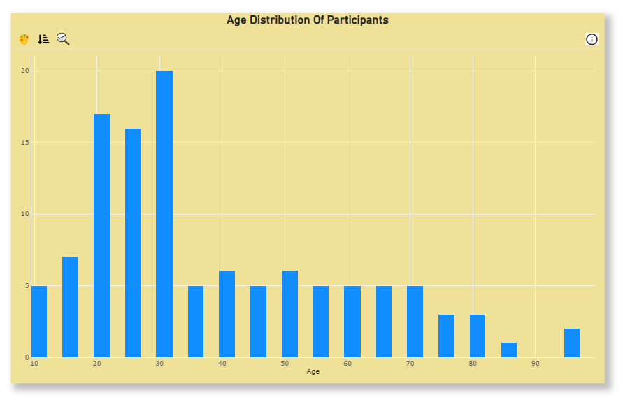
Q12. How does the age distribution of participants vary across different games?
Conclusion: According to our Dataset participants of Age Group Between 20-35 participated in most of the events. Some events may attract a younger cohort, reflecting the prominence of youth-focused disciplines, while others appeal to a broader age range.

Slide 16
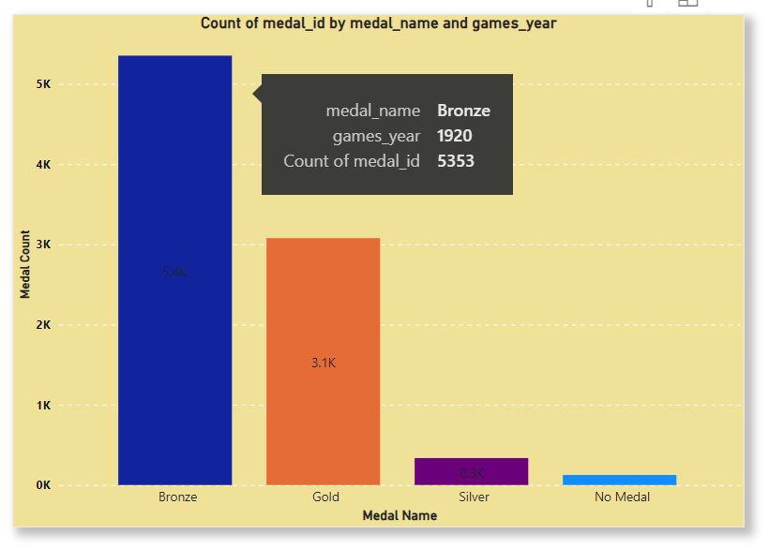
Q13. How many medals have been awarded in each Olympics?
Conclusion: Analyzing the number of medals awarded in each Olympics illuminates the scale and significance of athletic achievements over time. According to Dataset, In the Year 1920 More number Of Medals Got Distributed. Fluctuations in medal counts may reflect changes in the number of events, participant numbers.

Slide 17
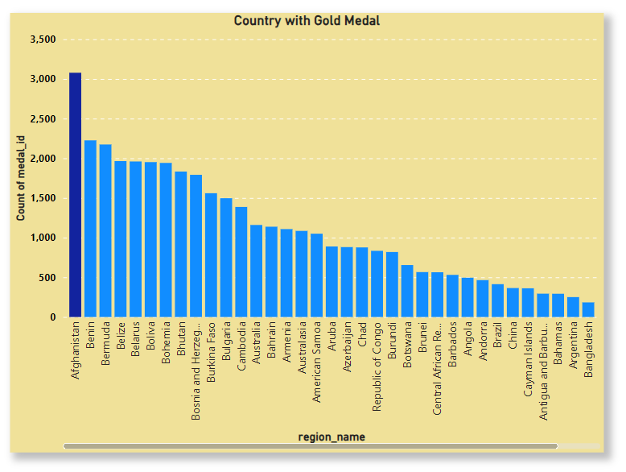
Q14. Which countries have the highest number of gold medals?
Conclusion: According to Our Dataset Afghanistan have won more number of Gold Medal. Examining countries with the highest number of gold medals underscores their dominance in Olympic competition. These nations showcase exceptional athletic prowess and rigorous training programs.

Slide 18
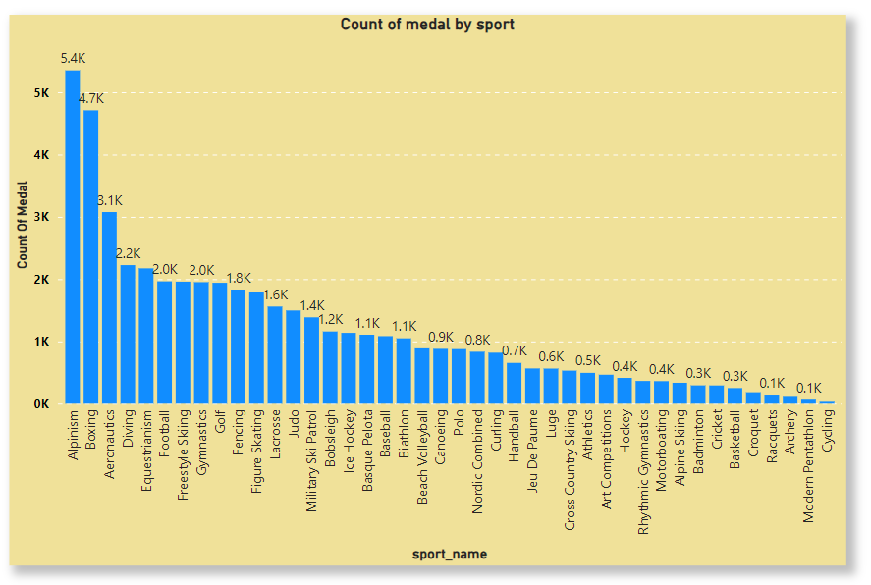
Q15. How does the medal distribution vary across different sports?
Conclusion:
Analyzing the medal distribution across different sports reveals varying levels of success and specialization among athletes. After Visualization we got to know that Sports like Alpinism, Boxing, etc have captured more number of medals. Certain sports may consistently produce a higher number of medalists, reflecting their competitive intensity or broader participation.

Slide 19
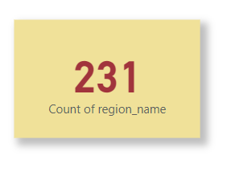
Q 16. How many regions or NOCs participate in each Olympic Games?
Conclusion:
According to Our Dataset 231 Regions have participated in Olympic Games. Examining the number of regions or National Olympic Committees (NOCs) participating in each Olympic Games sheds light on the global representation and inclusivity of the event. Understanding these dynamics provides insights into the diversity and scope of Olympic competition.

Slide 20
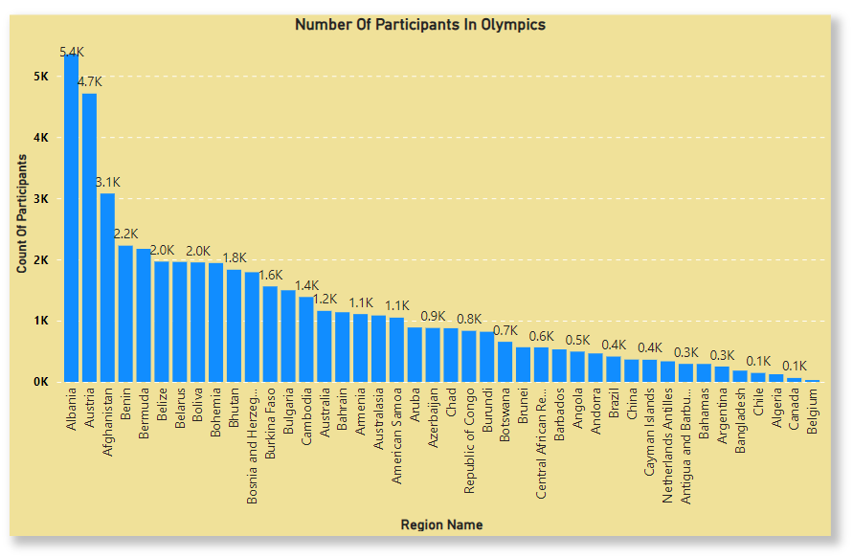
Q17. Which regions have the highest number of participants in the Olympics?
Conclusion:
Analyzing regions with the highest number of participants in the Olympics highlights hubs of athletic talent and competitive fervor. With this Dataset Albania and Austria have highest number of participants in Olympics While Canada and Belgium Have least. These regions demonstrate robust sports infrastructure and extensive athlete development programs.

Slide 21
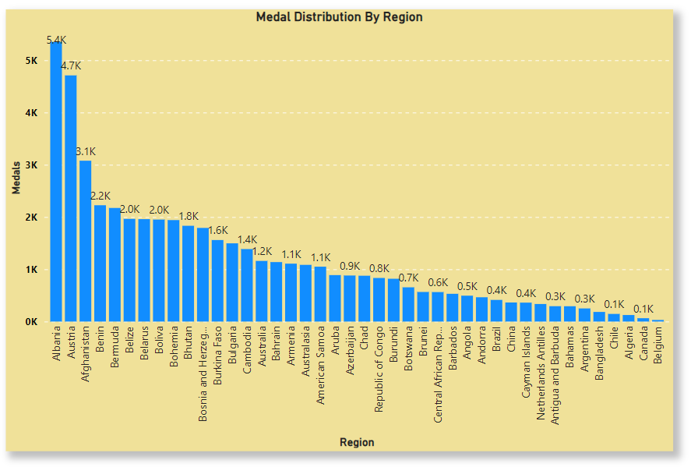
Q18. What is the distribution of medals among different regions?
Conclusion:
Examining the distribution of medals among different regions unveils disparities in Olympic success and athletic achievement. Certain regions like Albania, Austria consistently dominate medal counts, reflecting their strong sporting traditions and investment in athlete development.

Slide 22
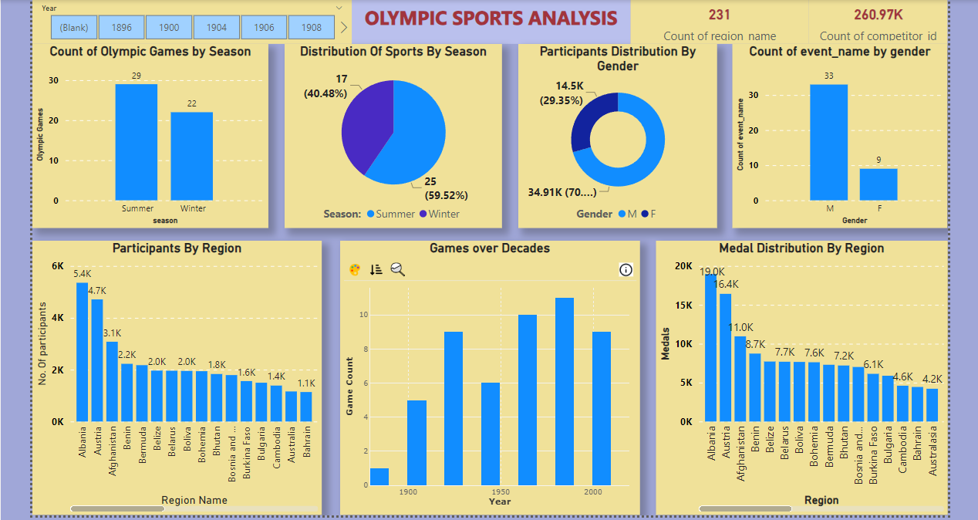
DASHBOARD:

Slide 23
Olympic Sports Analysis
EDA BY USING SQL AND EXCEL

Slide 24
Q1. Are there any trends or patterns in the frequency of hosting Olympic Games?
Conclusion:
Analyzing the frequency of hosting Olympic Games reveals smooth trends and patterns.
According to Dataset Singapore has hosted two time, Certain regions exhibit recurrent hosting
patterns for only one time, suggesting established infrastructure and cultural significance. Understanding these trends offers insights into the global landscape of Olympic event hosting.

Slide 25
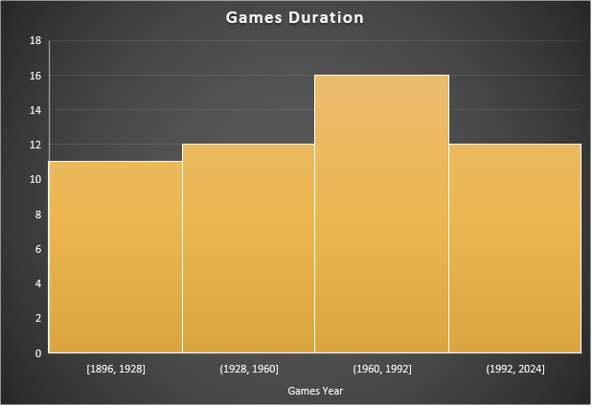
Q2. How has the duration of Olympic Games changed over time?
Conclusion:
Analyzing the duration of Olympic Games across years unveils notable shifts. With the help of Chart we can see that between 1960-1992 the game duration is long over. Changes in duration may reflect evolving event formats, organizational strategies, or societal influences. Understanding these fluctuations offers insights into the evolving nature of the Olympic Games, reflecting adaptations to meet modern expectations.

Slide 26
Q3. Are there any notable events or occurrences associated with specific Olympic Games?
Conclusion:
Analyzing event occurrences across Olympic Games unveils notable moments that have left a lasting impact on sports history. These events may include record-breaking performances, unexpected upsets, or symbolic gestures, shaping the narrative of each Games and leaving a legacy that resonates with athletes and fans worldwide.

Slide 27
Q4. Are there any emerging sports that have been recently added to the Olympics?
Conclusion:
Analysis of the "Sports by Year" table reveals notable additions to the Olympic roster in recent years. Emerging Sports like Gymnastics, Athletics, etc reflecting a progressive approach by the International Olympic Committee towards embracing contemporary athletic disciplines and diversifying the Games appeal.

Slide 28
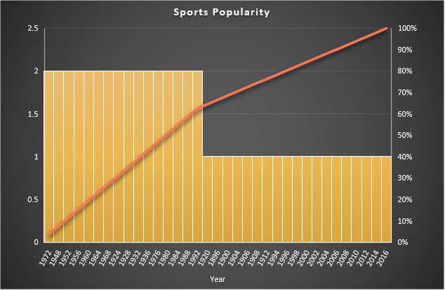
Q5. How has the popularity of certain sports changed over the years?
Conclusion:
Analyzing the popularity of sports across years reveals dynamic shifts in public interest and engagement. Fluctuations in popularity may reflect cultural trends, media coverage, or changes in sport regulations. Understanding these changes offers insights into evolving societal preferences and the evolving landscape of sports entertainment and participation.

Slide 29
Q6. Are there any sports that are specific to a particular region or culture?
Conclusion:
Analysis of the "Sports by Region" table indicates that certain sports are closely associated with specific regions or cultures. For instance, the sports like Gymnastics is deeply rooted in local traditions and hold cultural significance, reflecting the diversity of sporting heritage across different regions.

Slide 30
Q7. Are there any sports that have a higher number of events for one gender compared to others?
Conclusion:
After analysis of the Dataset table reveals disparities in event representation between genders in certain sports. Sports such as Athletics, Shooting and Cycling often feature more events for female participants, reflecting historical and cultural norms. Conversely, sports like Athletics and Shooting typically offer more events for male athletes, highlighting gender imbalances in Olympic programming.

Slide 31
Q8. Are there any new events that have been introduced in recent editions of the Olympics?
Conclusion:
Analysis of the "Events by Year" table highlights the introduction of several new events in recent editions of the Olympics. Notable additions include Gymnastics, Judo, Badminton, Swimming,etc. and the inclusion ofthese sports reflecting efforts to enhance inclusivity and appeal across diverse sporting disciplines.

Slide 32
Q 10. Are there any notable trends in the height and weight of participants over time?
Conclusion:
Analyzing height and weight data of participants over time unveils potential trends in athlete physique. Observing fluctuations may indicate shifts in training methods, nutrition, or sport-specific requirements. According to our dataset Height and Weight of participants falls in between 160-180 and 60-80 respectively. Understanding these trends provides insights into the evolving physical characteristics of Olympic athletes and their adaptation to changing athletic standards and demands.

Slide 33
Q11. Are there any dominant countries or regions in specific sports or events?
Conclusion:
Analyzing total medal counts by region across various sports reveals dominant countries or regions in specific events. Regions Like Australia, Spain, Switzerland Dominating in all events. Certain nations excel consistently in particular sports, showcasing their athletic prowess and strategic focus. Understanding these patterns sheds light on regional strengths and the dynamics of competition within individual sporting disciplines.

Slide 34
Q12. What factors contribute to the success or performance of participants from different countries?
Conclusion:
According to our Dataset we can see that most of the successful participants falls around weight of 60-70 and height around 170. Analysis of the table indicates that various factors contribute to the success or performance of participants from different countries in sports. These factors may include cultural attitudes towards athleticism, access to training facilities and resources.

Slide 35
Q13. Are there any countries that consistently perform well in multiple Olympic editions?
Conclusion:
Analyzing country performance across multiple Olympic editions reveals nations with consistent excellence in athletic competition. These countries demonstrate enduring strength across various sports and events, reflecting sustained investment in sports infrastructure, talent development, and strategic planning.

Slide 36
Q 14. Are there any sports or events that have a higher number of medalists from a specific region?
Conclusion:
According to given Dataset, Medal counts by sport often unveils regions with a higher concentration of medalists in specific events, indicating strengths or specialties. Events Such as Athletics, Shooting, Swimming have more number of medalists. Such trends may arise from cultural influences, training programs, or historical success. Understanding these patterns offers insights into regional sporting expertise and competitive advantages within the Olympic arena

Slide 37
Q 15. What are some notable instances of unexpected or surprising medal wins?
Conclusion:
Analyzing medal counts by event often reveals unexpected or surprising victories. With our Dataset we got to know that there are some events like Alpine skiing, Archery that have toght hold on medals. These instances highlight showcasing the essence of sportsmanship and the unpredictable nature of competition. Understanding these remarkable achievements adds depth to the Olympic narrative, inspiring athletes and fans alike.

Slide 38
Q 16: Are there any regions that have experienced significant growth or decline in Olympic participation?
Conclusion:
Examining regions with significant changes in Olympic participation unveils dynamic trends. Some regions experience remarkable growth, reflecting increasing investment in sports infrastructure and athlete development. Understanding these shifts provides insights into evolving global sports landscapes.

Slide 39
Q18. Are there any regions that have had a notable impact on the overall medal tally?
Conclusion: Analyzing regions with significant contributions to the overall medal tally reveals notable impacts. Certain regions consistently secure a substantial number of medals, Regions like USA, UK, Canada have won more number of medals. Understanding these influential regions provides insights into global sporting powerhouses and their contributions to Olympic success.

Slide 40
THANK YOU !!

